Slide 1
Data engineer: qualifications and skills
Jeff Leek
@jtleek
www.jtleek.com

Slide 2
What does a data engineer do?
Build data infrastructure
Manage data storage and use
Implement production tools

Slide 3

https://www.facebook.com/careers/jobs/a0IA000000G3ISfMAN/

Slide 4
What skills do they need?
Hardware knowledge
Databases
Data processing at scale
Software engineering

Slide 5
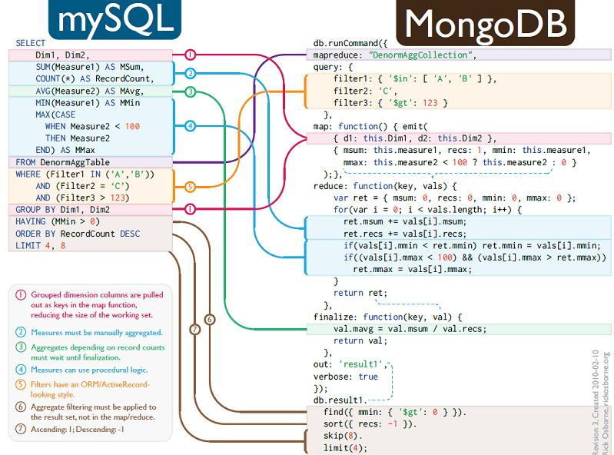
http://bicortex.com/introduction-to-mongodb-nosql-database-for-sql-developers-part-3/

Slide 6
Background of data engineers
Computer science and engineering
Quantitative + computer science
Information technology

Slide 7

https://www.cs.jhu.edu/

Slide 8
Solutions versus software

Slide 9
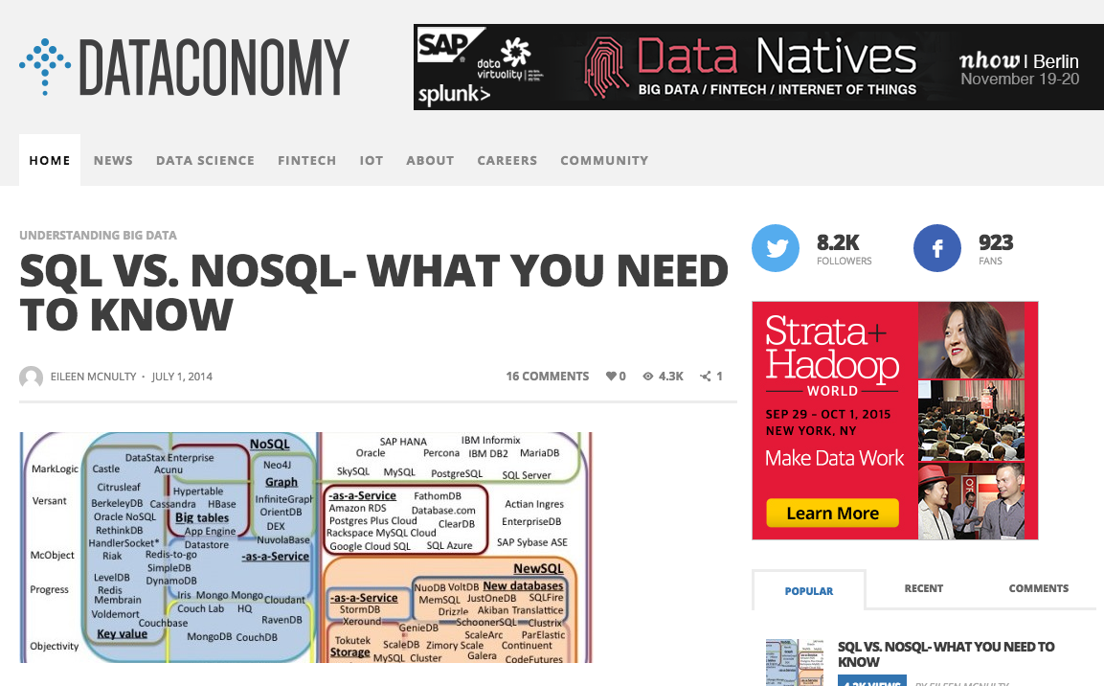
http://dataconomy.com/sql-vs-nosql-need-know/

Slide 10
Key characteristics
Willing to find answers on their own
Knows a bit of data science
Works well under pressure
Friendly but relentless

Slide 11
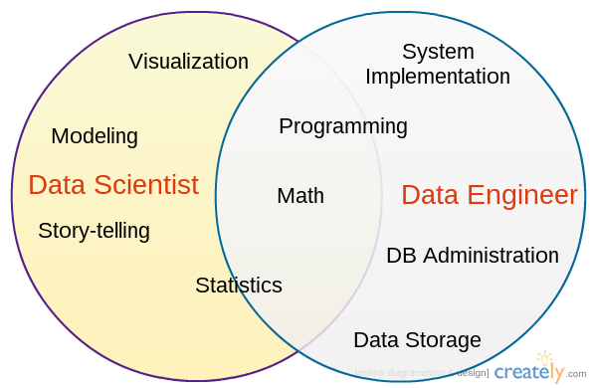
+ friendly!

